Slide 1
NHC Goalie Evaluations Package
6 Drills and Movements

Slide 2
Warm-up and Skating
1. Butterfly Slide & Recovery
2. Down Slide to Stop
3. Down Slide to Recovery
4. Shuffle Square
5. T-Push
Evaluation Points
Fluid movement.
Stick on ice.
Hands in good position.
Stay square.
Skating.

Slide 3
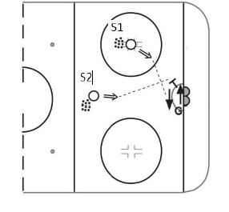
Save and Recovery
1. S1 is located on the face off dot, S2 is located in the slot; both with pucks.
2. Goaltender begins at the top of the crease square to S1.
3. S1 shoots low to far side.
4. After butterfly save, poser slide to middle and fully recover to feet.
5. S2 shoots to the same side that S1 is located.
6. After save, goaltender recovers to their feet square to S1
Evaluation Points:
1. Rebound control
2. Use of head to track shooters and puck
3. Recovery ability
4. Movement to square

Slide 4
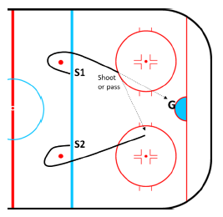
Rush with Shot or Pass and Rebound
1. S1 and S2 are located on blue line just inside opposite face off dots
2. Both S1 and S2 take off at same time towards center ice then curl around near face off dot.
3. S1 has puck he carries it into the zone and can either shoot or pass to S2. If shot taken must be done before top of circle and S2 can go for rebound.
4. Continue battle until puck is covered, in the corner, or goal.
Evaluation Points:
1. Angles
2. Save selection
3. Rebound control
4. Battle ability

Slide 5
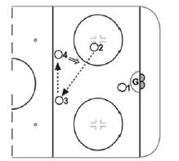
Movement and Far Shot Control
1. Shooter 2 passes to 3 who passes to 4.
2. Goalie follows the passes
3. Shooter 4 steps in and takes a shot.
4. Shooter 1 and shooter 2 go for rebound until play dead.
Evaluation Points:
1. Lateral movement and tracking
2. Angles
3. Getting set
4. Rebound control
5. Battle ability

Slide 6
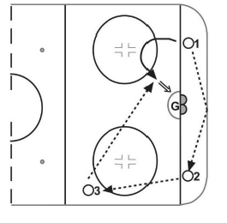
Lateral Feeds
1. S1 passed to S2 behind the net
2. S2 passes to S3 at top of the circle
3. S3 passes to S1 on backdoor
4. Goaltender follows puck throughout its movement
5. Goaltender should be at top of crease square to S3 when backdoor pass is made
6. Goaltender makes butterfly slide to backdoor to make save.
Evaluation Points:
1. Tracking of puck with head and body
2. Strong movement, getting set
3. Strong lateral movement, body control

Slide 7
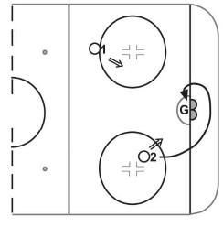
Scramble and Rebound
1. S1 located at top of circle, S2 located below face-off dot on opposite side – both with pucks
2. S1 shoots low to far side, goaltender makes save
3. S2 shoots sets puck for a rebound
4. S2 skates behind the net, picks up another puck and tries a wrap-around on the other side of the net
Evaluation Points:
1. Rebound control
2. Battle/scramble ability
3. Movement, body control

